Slide 1
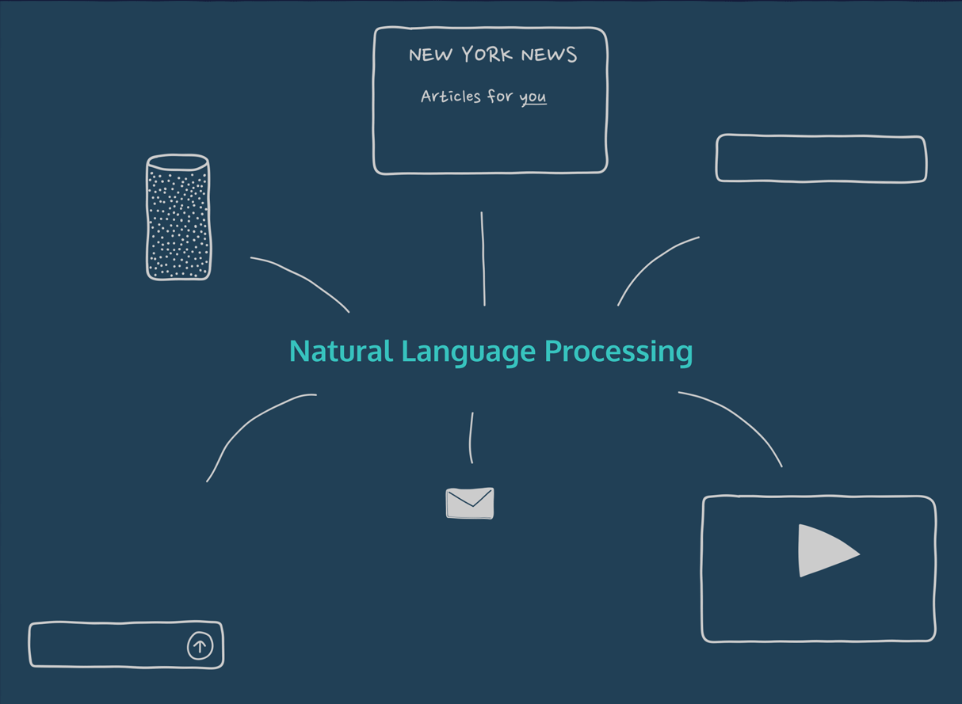
Introduction to Natural Language Processing

Slide 2
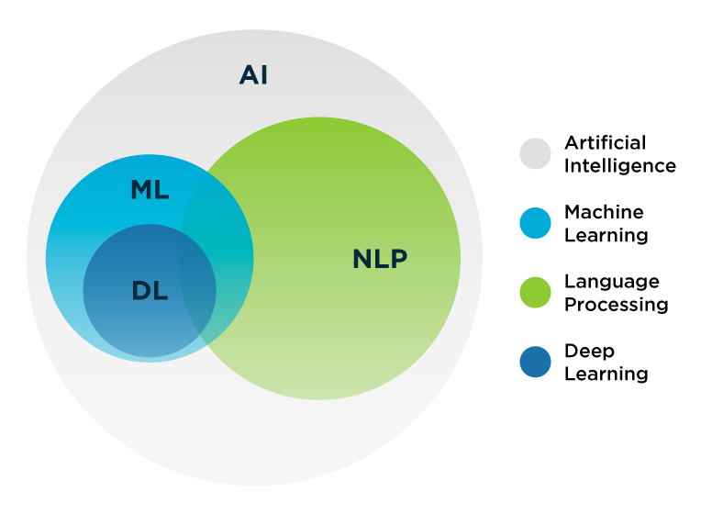

Slide 3


Slide 4
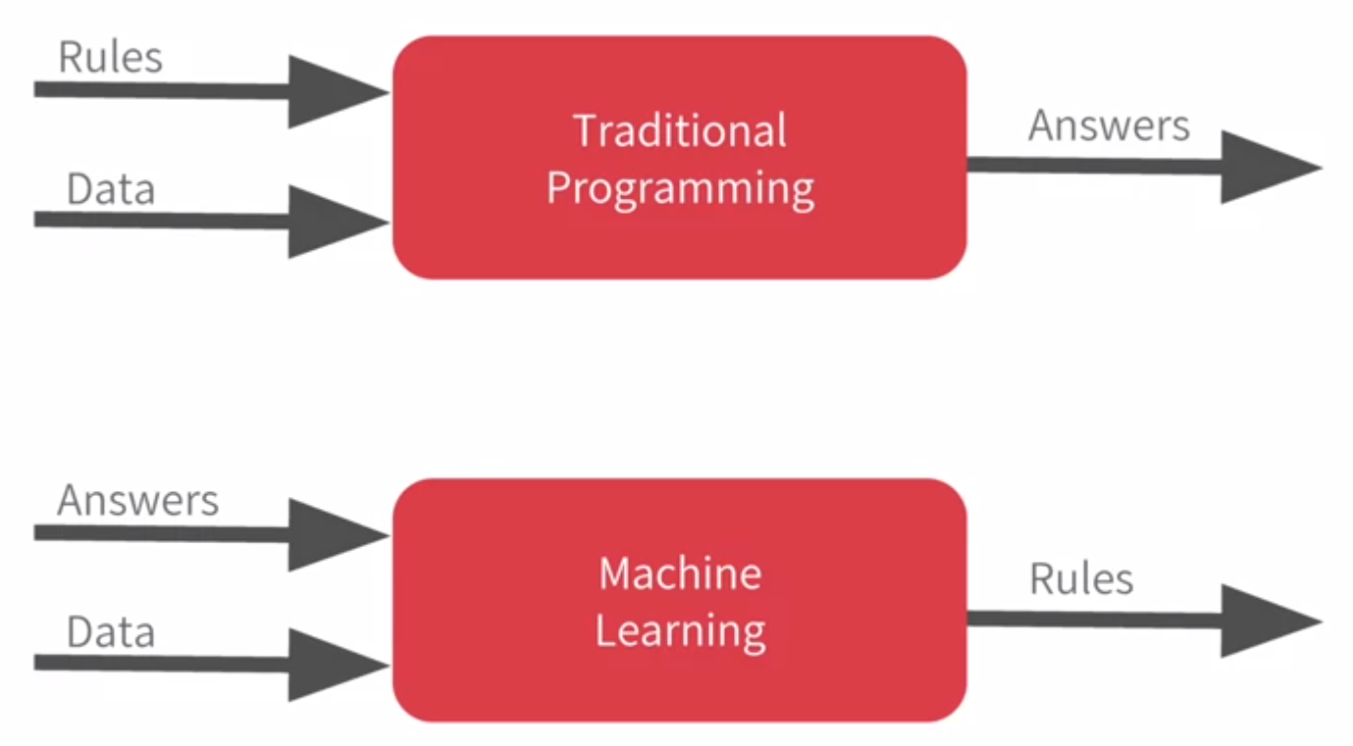
Let’s Revise Machine Learning

Slide 5
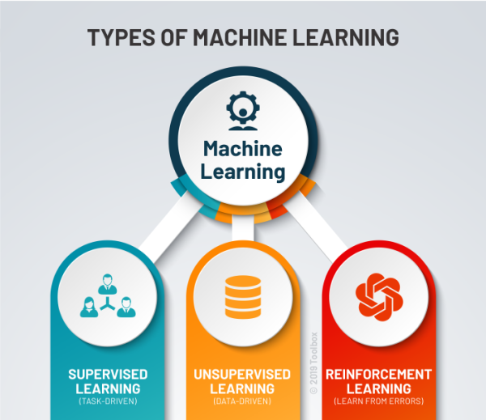

Slide 6
`
MATH QUIZ #1
Find the relation between LHS and RHS
Features Target
A B C Z
2 4 5 = 3
5 2 8 = 2
2 2 1 = 3
4 2 2 = 6
6 2 2 = 10
Training
Data
A*B - C

Slide 7


Slide 8
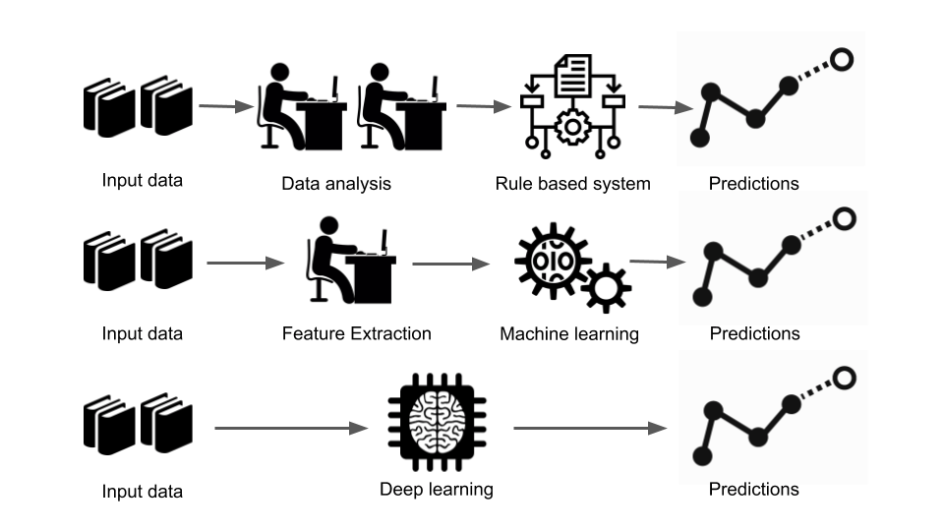
What we will be looking at –
Rule based approach
Machine Learning based approach
Deep Learning based approach
Model Explainability

Slide 9


